Slide 1
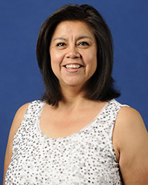
FY 2022 CATPA Grant Announcement
& Workshop
Kenya Lyons, Grant Manager

Slide 2
Agenda
9:00 AM | Welcome & Introductions
9:10 AM | Goal of Grant Workshop/Handout Materials
9:20 AM | FY22 Grant Managers Guidance Manual
10:20 AM | FY22 Application Review
11:20 AM | Reporting Forms Review
11:40 AM | ALPR Requirements
11:45 AM | Questions & Answers/Group Discussion

Slide 3
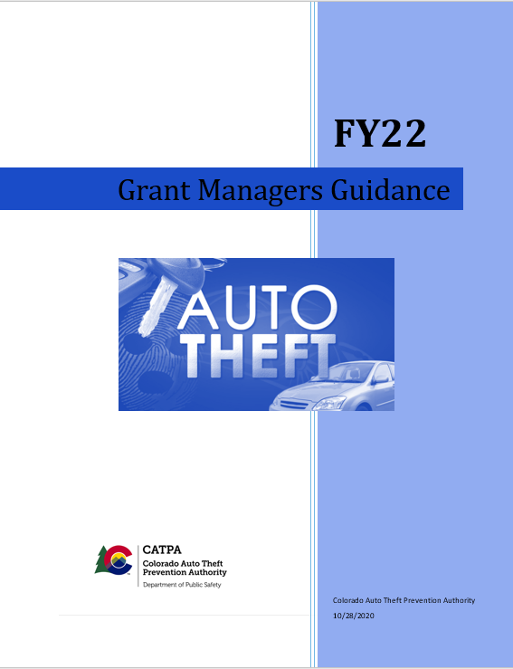
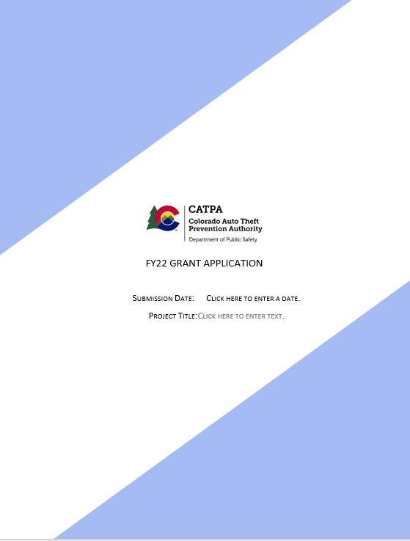
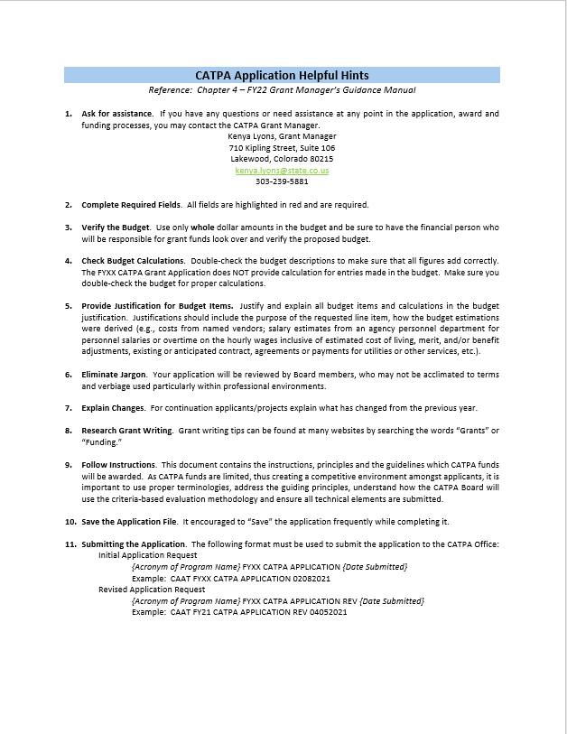
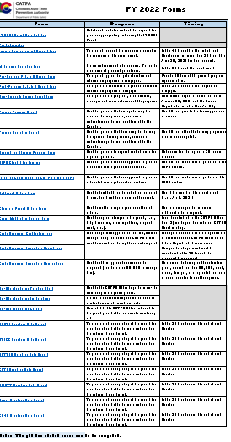
Materials & Handouts
Guide Application Checklist FY22 Forms

Slide 4
FY 2022 Grant Managers Guidance Manual
To be used as an instructional guide for completing the FY22 Application.
To provide foundational information on the qualifiers, limitations and scope of the CATPA grant application.
To provide transparency on Guiding Principles used by the CATPA Board for funding applicants.
To be used as a template for administering an awarded grant.

Slide 5
Chapter 1 - Introduction
CATPA’s Mission Statement
Background of the CATPA Grant Program
The CATPA Board of Directors
Grant Application Conditions
Grant Review an Evaluation Methodology
*Reference: FY22 Grant Manager Guidance Manual – page 4

Slide 6
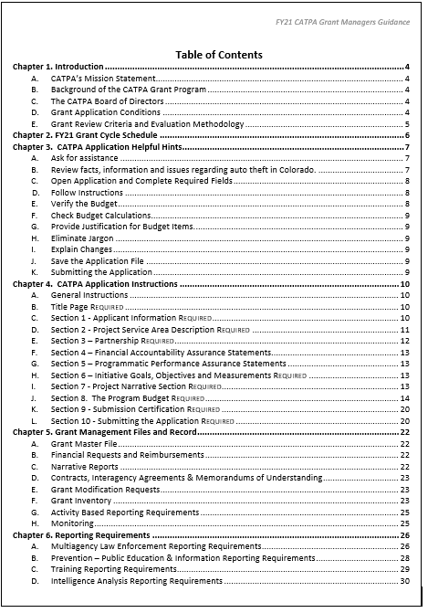
Page 2 – Table of Contents
Chapter 1 – Introduction and Background of CATPA
Chapter 2 – FY22 Application Schedule
Chapter 3 – Helpful Hints
Chapter 4 – Application Instructions
Chapter 5 – Files & Records (Upon Award)
Chapter 6 – Reporting Requirements (Upon Award)
Chapter 7 – Marketing Requirements (Upon Award)
Chapter 8 – Definitions
Chapter 9 – CATPA Board Guiding Principles

Slide 7
CATPA Board Guiding Principles
1. Review for Statutory and Regulation Predicates
  See Page 43 for list of predicates from §42-5-112 C.R.S. and 8 C.C.R. 1507-50
2. Identification and Anticipation of Funding ($4.5 - $5.7 million FY22)

Slide 8
CATPA Board Guiding Principles
Guiding Principles
Geographical Distribution
Initiative Apportionment
Successful Program
Crime Relevance
Auto Theft Per Capita Rate
Auto Theft and Vehicle Registration Rate
Consideration of Land, Population and Theft Rates
Land, Population, Theft Rates and Weighting Factors
Consideration of Multiagency Applications
*Reference: FY22 Grant Managers Guidance Manual – Chapters 9, pp.43-50

Slide 9
CATPA Board Guiding Principles
Application Evaluation
Technical Capacity – Most Important (70% Scoring)
  See Page 47 for instructions
Management Capacity (15% Scoring)
Past Performance (15% Scoring)
Cost/Price
*Reference: FY22 Grant Managers Guidance Manual – Chapters 9, pp.43-50

Slide 10
Programmatic Requirements & Forms
If a project is awarded funding, there are reporting requirements and forms that must be submitted to the CATPA Office.
Most Important: Grant Agreement – Special Conditions will outline specific requirements of the particular program.
Generally, requirements are based upon the type of initiatives that are funded by the CATPA Board and are located in the Grant Manager’s Guidance Manual – Chapter 6 (pp. 26-31).
Additional or modified reporting may be required by the CATPA Board, typically during the grant review process through the drafting/approval of the Grant Agreement, however the Board may require reporting during the course of the project.

Slide 11
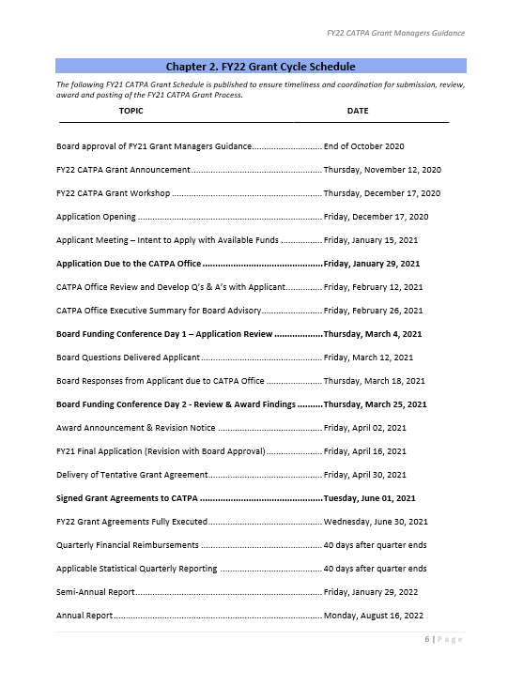
The Application Schedule
It is strongly advised to review the timelines of the FY22 Grant Cycle, page 6
*Reference: FY22 Grant Managers Guidance Manual - Chapter 2 – Grant Cycle Schedule

Slide 12

Key Notes on Grant File and Records
As CATPA is initiating On-Site Monitoring, it is strongly recommended to ensure all grant files and records are kept in order.
Grant Master File
Financial Requests & Reimbursements
Narrative Reports
Contracts & Interagency Agreements
Grant Modification Requests
Grant Inventory
Activity Based Reporting Requirements
Back-up Documentation & Correspondence
Memos
Misc.
Training
Activities
Reports
Inventory
Mods
Contract
Narratives
Financial
FY22 CATPA Grant Master File
*Reference: FY22 Grant Managers Guidance Manual - Chapter 5

Slide 13

FY22 Application Review
Recommend to use the Application Checklist
  Application is in Word®
  Only complete sections that are applicable to your application and those that are Required
  Word® format allows unlimited character length for narrative portions of the application. However, we recommend you consider that lengthy and wordy narratives may work against you during the review process.
  Many sections are standardized to ease effort of completion:
    “Check Box”
    “Drop Down Selection”
    “Open Text Box”
Application Checklist
*Reference: FY22 Grant Managers Guidance Manual - Pages 10 & 11

Slide 14
Pre-application helpful tips
Review facts, information and issues regarding auto theft in Colorado.
  Crime in Colorado website, https://coloradocrimestats.state.co.us/tops
  Local law enforcement records management system(s),
  Past performance and statistics of CATPA funded projects,
  Stolen Vehicle Database Repository (https://aticc.state.co.us/ or by calling 303-239-4368),
  National Insurance Crime Bureau (https://www.nicb.org/),
  Colorado Department of Local Affairs (https://www.colorado.gov/dola),
  Colorado Department of Revenue (https://www.colorado.gov/revenue),
  Colorado Division of Criminal Justice (https://www.colorado.gov/dcj),
  Auto Theft Prevention Authorities Committee (https://www.combatautotheft.org/),
  International Association of Auto Theft Investigators (https://www.iaati.org/),
  International Association of Chiefs of Police (https://www.theiacp.org/), or
  Other national, regional or state resources.
*Reference: FY22 Grant Managers Guidance Manual - Pages 7

Slide 15
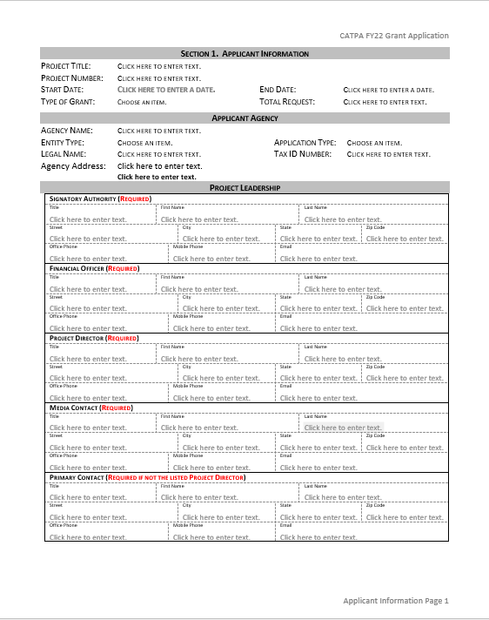
Section 1 – Applicant Information
Required to complete the Applicant Information, including the Applicant Agency (fiscal entity), and Project Leadership sections.
Project Leadership must identify the Signatory Authority, Financial Officer, Project Director, Media Contact and Primary Contact
Note: Walk-thru of the FY22 CATPA application
*Reference: FY22 Grant Managers Guidance Manual – Pages 10 & 11

Slide 16
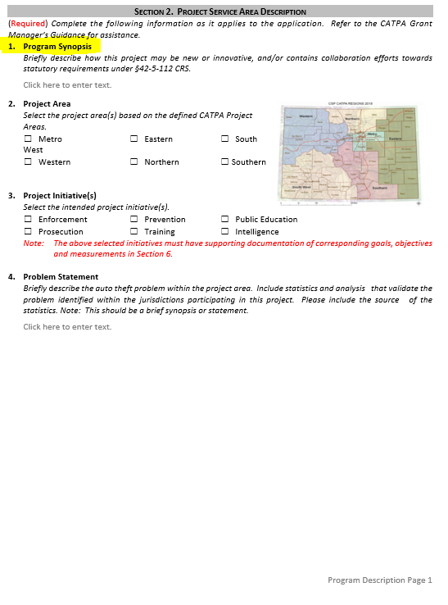
Section 2 – Project Service Area Description
One of the most import sections, Program Synopsis – statutory requirements (page 43)
Identify the area where the requested program will be operating. Check all areas that apply using the CATPA Map (based on Judicial Districts)
Identify the type of initiative that the project will address. Consider that each initiative selected will require corresponding goals, objectives and measurements.
Compose a Problem Statement
  Note: This should be a STATEMENT not a NARRATIVE
*Reference: FY22 Grant Managers Guidance Manual - Page 11-12

Slide 17
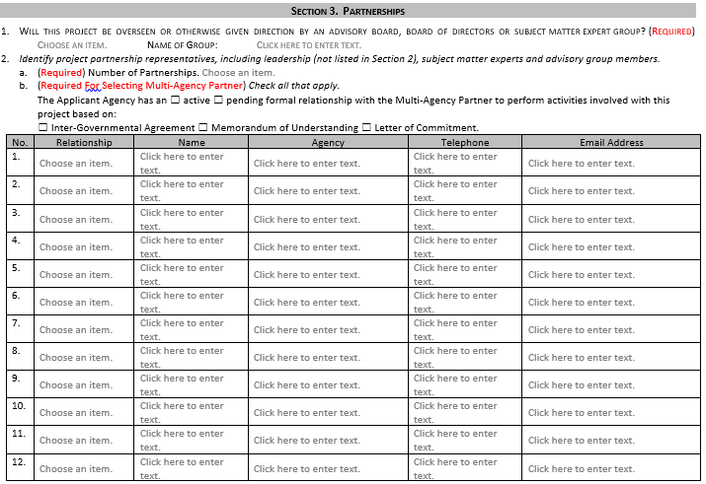
Section 3 - Partnerships
Answer questions 1 & 2
Use definitions of Partnership Representatives (GMGM Chapter 4 Page 12)
  Advisory Partners
  Expertise Partners
  Directing Partners
  Multi-Agency Partners
*Reference: FY22 Grant Managers Guidance Manual - Page 12

Slide 18
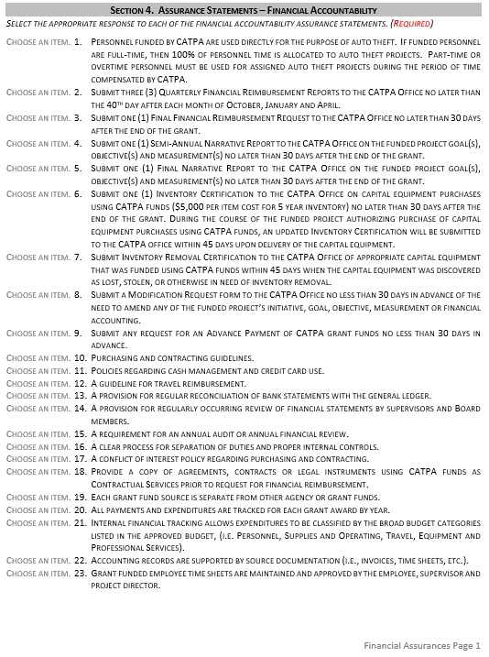
Section 4 – Financial Assurance Statements
It is required to answer all 23 Statements.
All twenty (23) statements must be answered by selecting either “Agree” or “Not Applicable” in the dropdown selection box.
*Reference: FY22 Grant Managers Guidance Manual - Page 13

Slide 19
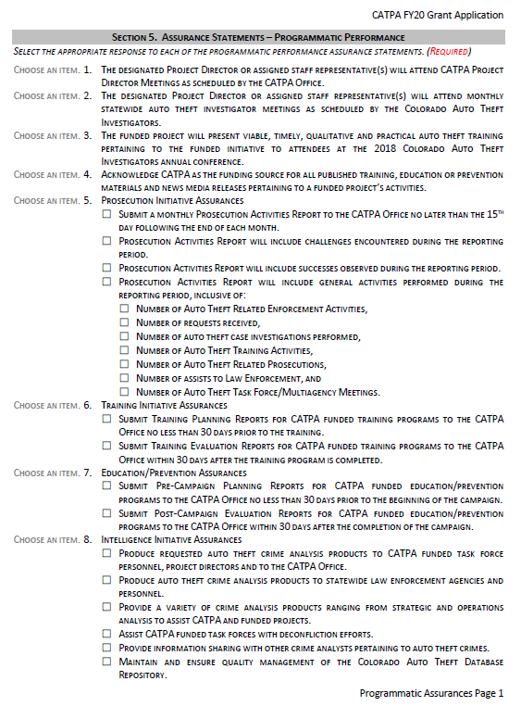
Section 5 – Programmatic Assurance Statements
It is required to answer all 9 Statements.
All nine (9) statements must be answered by selecting either “Agree” or “Not Applicable” in the dropdown selection box.
If the Applicant is not selecting a particular initiative for funding purposes, then select “Not Applicable.”
*Reference: FY22 Grant Managers Guidance Manual - Page 13

Slide 20
Section 6 – Initiative, Goals & Measurements
Initiatives corresponding to those selected in Section 2 are required
You are not limited to one initiative and are encouraged to select all initiatives that meet the project’s abilities, skills and knowledge.
If a particular initiative is not selected, leave the page blank.
For each selected initiative, the following must be identified and completed:
  Goal(s). A minimum of one (1) of the listed goals must be checked.
  Objective(s). A minimum of one (1) objective must be established for each selected goal.
  Performance Measurement(s). A minimum of one (1) measurement must be established for each stated objective.
Objectives must meet the S.M.A.R.T. +C Model – See Appendix B
Objectives must be related to the selected goal(s) and may be either qualitative or quantitative performance objectives.
Stated objectives must be addressed and reported during the Semi-Annual and Annual Reporting.
*Reference: FY22 Grant Managers Guidance Manual - Page 13 & Appendix B

Slide 21
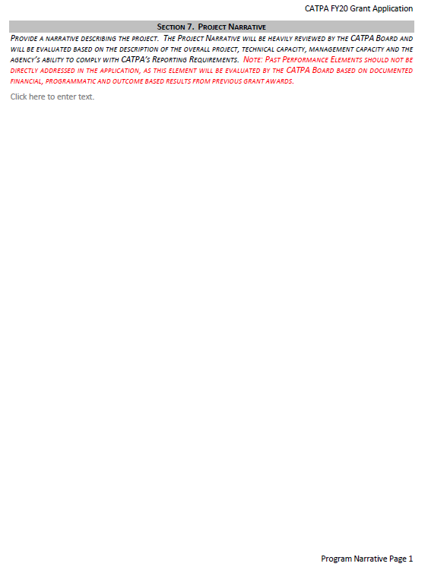
Section 7 – Project Narrative
Second most important section of the Application for the Board’s consideration of funding.
Applicants are urged to consider the following framework for composing the Narrative:
  Review Definitions of terms in Chapter 8 (Pages 33-42).
  Project Synopsis: “How the project will address the problem statement”
  Project Detail Description: “Who, What, When, Why and How”
    Technical Capacity
    Management Capacity
    Do NOT include any accomplishments of Past Performance
*Reference: FY22 Grant Managers Guidance Manual - Page 13 and Chapter 8

Slide 22
Section 7 - Project Narrative (continued)
Technical Capacity
Management Capacity
Value
Multiagency Effort
Reasonableness of Success
Project Plan
Timeline
Continuation of Existing Project
Expansion of Existing Project
Impact of Funding Reduction or Denial
Operational Management
  Personnel allocation
  Personnel supervision
  Protocols, Policies, Procedures
  Roles & Responsibilities
Financial Management
  Grant Administration
*Reference: FY22 Grant Managers Guidance Manual - Pages 13 &14, and Chapter 9

Slide 23
A Word About Funding Priorities
Funding Priorities should be addressed in the Narrative and also identified in the Budget Worksheets.
To clarify, priorities are described as:
Critical Funding - These are funds that support the essential components of the project and, without the funding, the project would fail to meet the goal(s) identified in the application.
Essential Funding - In order to maintain the status quo, these funds allow an ability to continue the project without hindrance, or reduction efforts. These funds typically include items that provide sustenance and support to critical funding resources.
Supplemental Funding - Supplemental funds provide the ability to enhance, elevate, enrich, expand or otherwise augment the project’s effectiveness and/or efficiency.
*Reference: FY22 Grant Managers Guidance Manual - Chapter 9 – page 48

Slide 24
Section 8 – The Program Budget
Many applicants find this the most challenging
Sufficient detail is needed to demonstrate and illustrate financial stewardship of the CATPA Cash Fund.
Attaching Spreadsheets or other supporting documents are permitted to assist the CATPA Office and Board in understanding how calculations were derived.
  The CATPA Office performs Budgetary Analysis of all applications for review and briefing to the Board. In the event the CATPA Office requests additional documentation, it is to your benefit to provide the information in a timely manner.
All justifications must be directly related to the purpose of the CATPA Cash Fund: “Auto Theft and Related Crimes” under §42-5-112 C.R.S.
*Reference: FY22 Grant Managers Guidance Manual - Chapter 4 – pages 14 - 21

Slide 25
Section 8 – The Program Budget: Preparation
Use the Board’s Guiding Principles to consider your overall request (GMGM Chapter 9 Page 43). Keep in mind:
  Not one single applicant has been awarded the entire Spending Authority,
  Apportionment will be principally based on the Guiding Principles, and
  Look up your “Project Area” to get a measure of the variables calculated for funding guidance (page 44).
  All requested ‘line items’ should be identified as being either critical, essential or supplemental. (GMGM Chapter 9 Page 48)
  Consider what would be the impact to your program if the requested funds were reduced or otherwise not awarded. (GMGM Chapter 4 Page 14)
  Review Allowable and Non-Allowable Expenses (GMGM Chapter 4 Page 16)
*Reference: FY22 Grant Managers Guidance Manual – Chapter 9

Slide 26
Section 8 – The Program Budget: Other Guidance
The budget request must cover the entire project duration (July 1, 2021 through June 30, 2022).
Use Whole Dollar Amounts
CATPA does not require matching funds, however, if contributing costs are proposed in the application and budgetary calculations, the contributing costs should be identified for the Board’s consideration. (GMGM Chapter 4 Page 14)

Slide 27
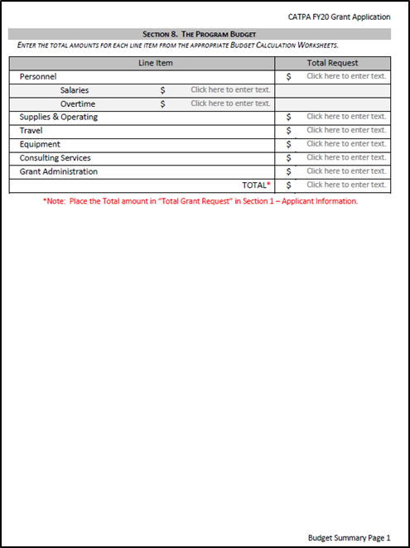
Section 8 – The Program Budget
This page should not be completed until all the Worksheets are completed first.
The final calculations from each of the Worksheets are then used on the Budget Summary Page.
  The FY22 CATPA Application is not configured to automatically calculate the budget entries.
*Reference: FY22 Grant Managers Guidance Manual – Page 16

Slide 28
Section 8.A & 8.B - Personnel Salaries Budget
This budget category should be used when requesting salary and benefits (e.g., FICA, PERA, Medicare, etc.) of full-time personnel to auto theft.
Personnel salary costs can include personal leave (e.g., sick leave, vacation leave, bereavement leave, etc.).
Personnel salary costs attributed to “Administrative Leave” must have a direct relationship with performance of an auto theft project or assignment.
If this project includes contractual services or grant administration, these costs should be included in Consultant/Professional Services or Grant Administration sections of the budget.
*Reference: FY22 Grant Managers Guidance Manual – Page 17

Slide 29
Section 8.C & 8.D - Overtime Budget
This budget category should be used when requesting overtime costs for individuals in performance of auto theft projects/assignments.
Overtime costs can not include personal leave (e.g., sick leave, vacation leave, bereavement leave, etc.) or “Administrative Leave.”
If this project includes contractual services or grant administration, these costs should be included in Consultant/Professional Services or Grant Administration sections of the budget.
*Reference: FY22 Grant Managers Guidance Manual – Page 17

Slide 30
Section 8.E & 8.F - Supplies and Operating Budget
There are 12 categories for this section:
Building Expenses
Telecommunications
Office Expenses (Less than $5,000 per item)
Computer and Software (Less than $5,000 per item)
Enforcement Supplies/Equipment (Less than $5,000 per item)
Uniform Expenses FY22 CATPA Grant Managers Guidance
Vehicle Supply and Maintenance (Less than $5,000 per item)
Registration Fees
Membership Fees
Community Education
Investigative Funds
Training/Meeting Expenses
*Allowable and Non-Allowable expenses (page 16 & 19)
*Reference: FY22 Grant Managers Guidance Manual – Page 18

Slide 31
Section 8.G & 8.H – Travel Budget
This line item is used for any travel expenses for project personnel by either Conference Travel or Training & Other Travel.
This line item is NOT used for Membership or Training Registration Fees.
Indicate if the travel is in In-State or Out-of-State.
Out of Country travel expenses are not allowed.
Where a jurisdiction has an established travel policy, those rates may be used.
Otherwise, state travel rates are the maximum allowed. CONUS (per diem rates) and Mileage Rates
*Reference: FY22 Grant Managers Guidance Manual – Page 19

Slide 32
Section 8.I & J - Equipment Budget
All items with a unit cost of more than $5,000 must be listed as in this section.
Items purchased for more than $5,000 are subject to the State inventory requirements.
Capital equipment may be purchased with grant funds and in accordance with the approved CATPA budget.
Capital equipment becomes the property of the recipient agency and remains in possession of the original agency so long as it continues to be used for auto theft prevention activities as approved by the CATPA Board.
*Reference: FY22 Grant Managers Guidance Manual – Pages 19 & 20

Slide 33
Section 8.K & 8.L - Consulting Services Budget
Consultant and professional services are allowable under the CATPA grant.
You must be able to summarize the cost- benefit for the utilization of consultative services.
Identify the impacts that may likely occur if this is not funded.
Recommended to articulate the use of statements of work, discovery projects, project agreements and/or contracts for conditional use of the requested funds.
Recommended to list specific vendors in the event of approved funding for possible allowance of a “grant specified vendor” through procurement processes.
*Reference: FY22 Grant Managers Guidance Manual – Page 20

Slide 34
Section 8.M - Grant Administration Budget
CATPA allows a maximum of 5% of the subtotal of requested funds to be appropriated for grant administration.
As with all other sections, it is strongly advised to place a brief justification for why grant administration funding is being requested.
*Reference: FY22 Grant Managers Guidance Manual – Page 21

Slide 35
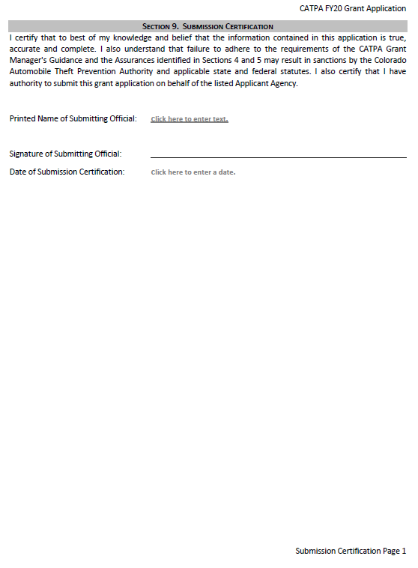
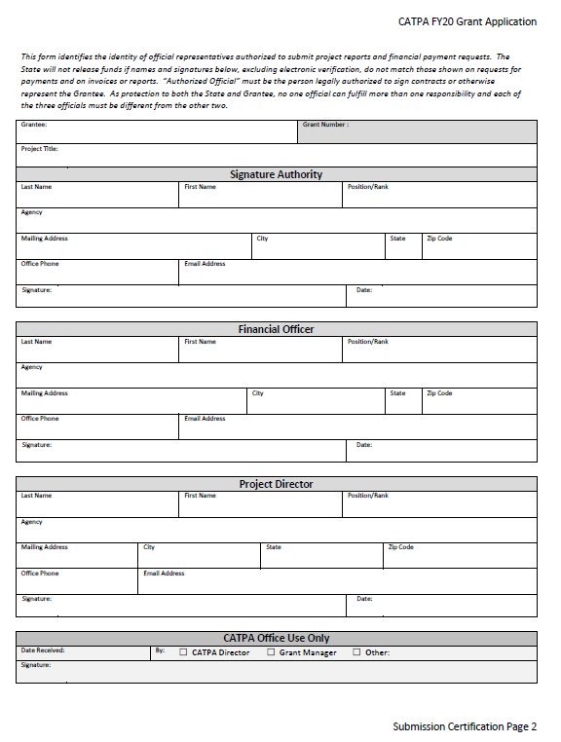
K. Section 9 - Submission Certification
The Submission Certification must be completed by a person identified as an Authorized Official:
  Signatory Authority
  Project Director
  Financial Officer
The Authorized Officials must be identified and completed
*Reference: FY22 Grant Managers Guidance Manual – Page 21

Slide 36
The Award Schedule
Multiagency Policies and Agreement Within 30 days from the start of the award
Policy, Procedure or Protocols Within 30 days from the start of the award
Inventory Certification Within 30 days from the start of the award
Pre-Program Public Prevention Report No less than 30 days prior to the program deployment
Post-Program Public Prevention Report No less than 30 days prior to the program completion
Training Planning Report No less than 30 days prior to the planned training
Training Evaluation Report No less than 30 days prior to the completion of training
Applicable Statistical Monthly Reporting Within 30 days from the end of the month
Quarterly Financial Reimbursements Within 40 days from the end of the quarter
Applicable Statistical Quarterly Reporting Within 30 days from the end of the quarter
Semi-Annual Report Due Date January 30, 2022
Annual Report Due Date July 30, 2022
*Reference: FY22 Grant Managers Guidance Manual – Chapter 6

Slide 37
FY22 CATPA Grant Forms Review
Authorized Officials Form
Change in Project Officials Form
Inventory Certification Form
Inventory Removal Form
Financial Payment Request Form
Modification Request Form
Semiannual and Annual Program Narrative Report
Multiagency Reporting Requirements
Pre-Program Public Education/Prevention Report
Post-Program Public Education/Prevention Report
Training Planning Report
Training Evaluation Report
On-Site Monitoring Sample Letter
On-Site Monitoring Checklist
On-Site Monitoring Guidance Introduction
FY22 Grantee Forms

Slide 38
Questions & Discussions
Kenya Lyons DESK 303-239-5881 CELL 303-253-0694 kenya.lyons@state.co.us Krystal Cook-Matson OFFICE 303-239-5882

Slide 39
Information and Support
CATPA Website:
www.Colorado.gov/pacific/csp/coloradoautotheftpreventionauthority
Kenya Lyons
303-239-5881 (Office)
Kenya.lyons@state.co.us

